Slide 1
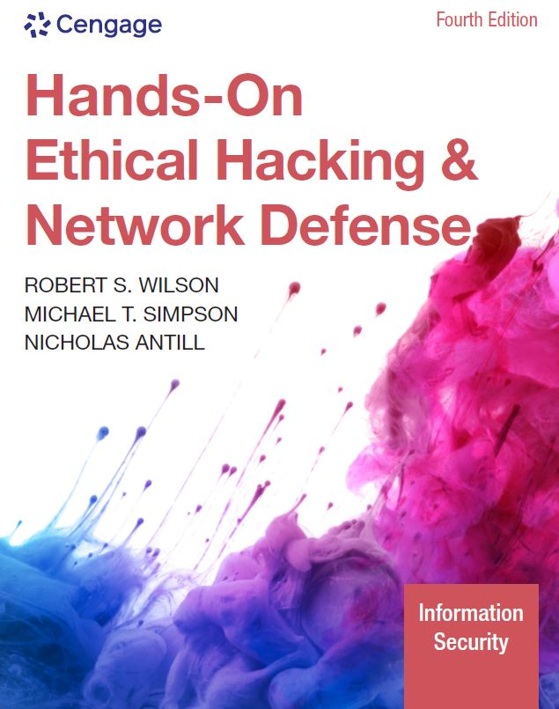
Hands-On Ethical Hacking and Network Defense,
Edition 4
Module 2: TCP/IP Concepts Review
Simpson, Antill, Wilson, Hands-On Ethical Hacking and Network Defense, 4th Edition. © 2023 Cengage. All Rights Reserved. May not be scanned, copied or duplicated, or posted to a publicly accessible website, in whole or in part.

Slide 2
Module Objectives
By the end of this module, you should be able to:
  Explain the TCP/IP protocol stack
  Explain the basic concepts of IP addressing
  Explain the binary, octal, and hexadecimal numbering systems

Slide 3
Overview of TCP/IP (1 of 2)
Protocol
  Language used by computers to communicate with one another over the Internet or across an office
  Transmission Control Protocol/Internet Protocol (TCP/IP)
    Most widely used
TCP/IP stack: Combination of two protocols (TCP and IP)
  Four distinct layers
    Network
    Internet
    Transport
    Application

Slide 4
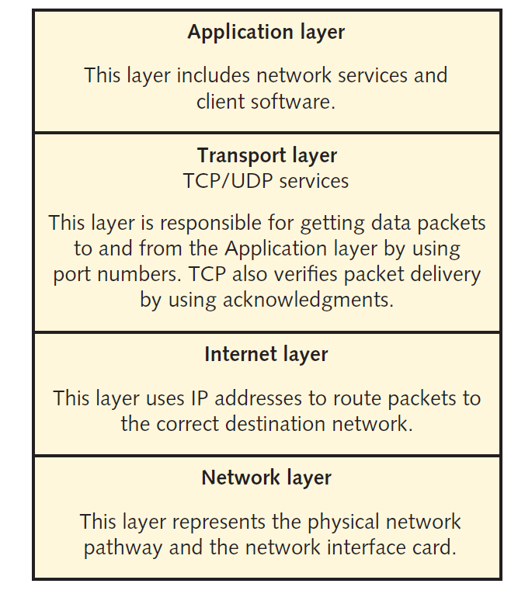
Overview of TCP/IP (2 of 2)
Figure 2-1 The TCP/IP protocol stack

Slide 5
The Application Layer
Protocols are the front end to the lower-layer protocols in the TCP/IP stack
  This layer is what you can see and touch

Slide 6
Application-Layer Programs
Application | Description
Hypertext Transfer Protocol Secure (HTTPS) | The primary protocol used to communicate over the web (see RFC 2818 at www.ietf.org for details)
File Transfer Protocol (FTP) | Allows different operating systems (OSs) to transfer files between one another
Simple Mail Transfer Protocol (SMTP) | The main protocol for transmitting email messages across the Internet
Simple Network Management Protocol (SNMP) | Primarily used to monitor devices on a network, such as monitoring a router’s state remotely
Secure Shell (SSH) | Enables users to securely log on to a remote server and issue commands interactively
Internet Relay Chat (IRC) | Enables multiple users to communicate over the Internet in discussion forums
Telnet | Enables users to insecurely log on to a remote server and issue commands interactively

Slide 7
The Transport Layer
Encapsulates data into segments
  Segments can use TCP or UDP to reach a destination host
    TCP is a connection-oriented protocol, which means the sender doesn’t send any data to the destination node until the destination node acknowledges that it’s listening to the sender
TCP three-way handshake example
  Computer A sends computer B a SYN (synchronize) packet
  Computer B replies with a SYN-ACK packet set
  Computer A replies with an ACK (acknowledgement) packet

Slide 8
TCP Segment Headers (1 of 2)
Critical components of a TCP header:
  TCP flags
  Initial sequence number (ISN)
  Source and destination port numbers
Abused by hackers
  To protect a network, you need to know the basic methods of hacking into networks

Slide 9
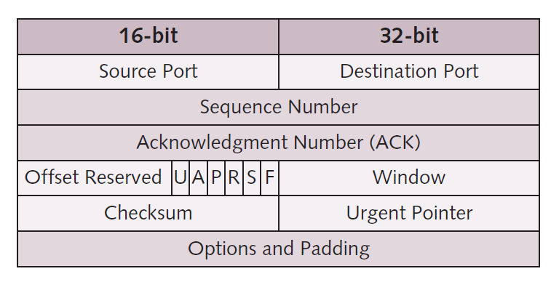
TCP Segment Headers (2 of 2)
Figure 2-2 TCP header diagram

Slide 10
TCP Flags
Each flag occupies one bit of the TCP segment
  Can be set to 0 (off) or 1 (on)
Six flags of a TCP segment
  SYN flag: Synchronize flag signifies the beginning of a session
  ACK flag: Acknowledgment flag acknowledges a connection
  PSH flag: Push flag is used to deliver data directly to an application
  URG flag: Urgent flag signifies urgent data
  RST flag: Reset flag resets or drops a connection
  FIN flag: Finish flag signifies that the connection is finished

Slide 11
Initial Sequence Number
ISN is a 32-bit number
  Tracks packets received by a node
  Allows reassembly of large packets that have been broken up into smaller packets
  ISN is sent through steps one and two of TCP three-way handshake
    Sending node ISN is sent with SYN packet
    Receiving node ISN is sent back to the sending node with SYN-ACK packet

Slide 12
TCP Ports (1 of 8)
TCP packet
  Has two 16-bit fields
    Contains source and destination port numbers
Port
  Logical, not physical, component of a TCP connection
  Can be assigned to a process that requires network connectivity
  Example: The HTTPS service uses port 443 by default
Helps you stop or disable unnecessary services
  The more services running on a server, the more ports are open for a potential attack

Slide 13
TCP Ports (2 of 8)
Only 1023 ports are considered well known
  List of well-known ports
    Visit the Internet Assigned Numbers Authority (IANA): www.iana.org
Ports 20 and 21
  File Transfer Protocol (FTP)
  Was the standard for moving or copying large files
    Used today to a lesser extent because of the popularity of HTTP
  Requires a logon name and password
  More secure than Trivial File Transfer Protocol (TFTP)

Slide 14
TCP Ports (3 of 8)
Port 22
  Secure Shell (SSH)
  Uses encryption and authentication
    To create a secure channel over an unsecure network
  Used to secure logons, file transfers, and port forwarding
  FTP using SSH is known as SFTP
Port 25
  Simple Mail Transfer Protocol (SMTP)
    Email servers listen on this port

Slide 15
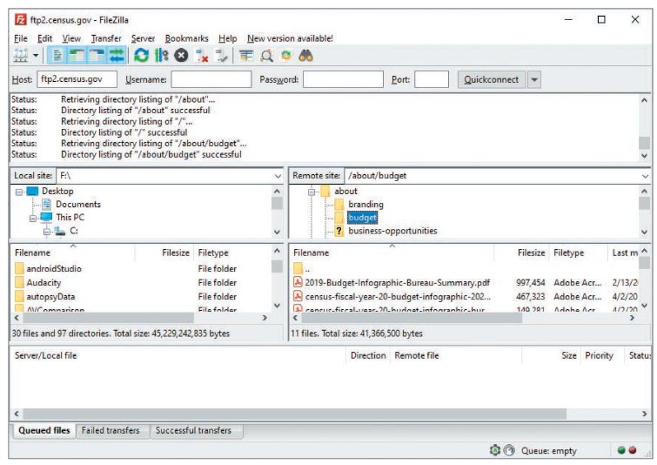
TCP Ports (4 of 8)
Figure 2-3 Connecting to an FTP site

Slide 16
TCP Ports (5 of 8)
Port 53
  Domain Name System (DNS)
    Used to connect users to websites using URLs instead of IP addresses
    Most networks require a DNS server
Port 69
  Trivial File Transfer Protocol
    Used for transferring router and backup router configurations
Port 80
  Hypertext Transfer Protocol (HTTP)
    Used when connecting to a web server

Slide 17
TCP Ports (6 of 8)
Port 143
  IMAP
  Used by email clients to retrieve email messages from a mail server over a TCP/IP connection
Port 443
  Secure Hypertext Transfer Protocol
    Used when you connect to a web server
    Typically, reserved for secure connections
Port 993
  IMAP over SSL/TLS uses port 993
  Preferred over the unsecured version IMAP, which uses port 143

Slide 18
TCP Ports (7 of 8)
Port 110
  Post Office Protocol 3 (POP3)
    Used for retrieving email messages from a mail server
Port 119
  Network News Transfer Protocol
    Used to connect to a news server for use with newsgroups

Slide 19
TCP Ports (8 of 8)
Port 135
  Remote Procedure Call (RPC)
    Critical for operation of Microsoft Exchange Server and Active Directory
Port 139
  NetBIOS
    Used by Microsoft’s NetBIOS Session Service to share resources
    Port 143
  Internet Message Access Protocol 4
    IMAP4 uses this port to retrieve email

Slide 20
User Datagram Protocol (UDP)
Fast but unreliable delivery protocol
  Operates on the Transport layer
  Used for its speed
    Does not need to verify whether the receiver is listening or ready to accept the packets
  UDP depends on higher layers of TCP/IP stack to handle problems
  Referred to as a connectionless protocol

Slide 21
The Internet Layer
Routes packets to a destination address
  Uses a logical address (i.e., IP address)
  IP addressing packet delivery is connectionless
Internet Control Message Protocol (ICMP)
  Sends messages related to network operations
  Helps network professionals to troubleshoot network connectivity problems
    ping command
  Tracks the route a packet traverses from a source IP address to a destination IP address
    traceroute command

Slide 22
ICMP Type Codes (1 of 3)
ICMP type code | Description
0 | Echo Reply
3 | Destination Unreachable
4 | Source Quench
5 | Redirect
6 | Alternate Host Address
8 | Echo
9 | Router Advertisement
10 | Router Solicitation
11 | Time Exceeded
12 | Parameter Problem
13 | Timestamp
14 | Timestamp Reply

Slide 23
ICMP Type Codes (2 of 3)
ICMP type code | Description
15 | Information Request
16 | Information Reply
17 | Address Mask Request
18 | Address Mask Reply
19 | Reserved (for Security)
20 to 29 | Reserved (for Robustness Experiment)
30 | Traceroute
31 | Datagram Conversion Error
32 | Mobile Host Redirect
33 | IPv6 Where-Are-You
34 | IPv6 I-Am-Here
35 | Mobile Registration Request

Slide 24
ICMP Type Codes (3 of 3)
ICMP type code | Description
36 | Mobile Registration Reply
37 | Domain Name Request
38 | Domain Name Reply
39 | Skip
40 | Photuris
41 to 255 | Reserved

Slide 25
Knowledge Check Activity 2-1
The netstat command indicates that POP3 is in use on a remote server. Which port is the remote server most likely using?
Port 25
Port 110
Port 143
Port 80
Notes:
Instructions:
Use the Knowledge Check questions to periodically pose a question to students during class to gauge how well they can recall the material that was presented.

Slide 26
Knowledge Check Activity 2-1: Answer
Which port is the remote server most likely using?
Answer: b. Port 110
One option to retrieve email from a mail server is to access port 110 using Post Office Protocol 3 (POP3).

Slide 27
Polling Activity 2-1
On a Windows computer, what command can you enter to show all open ports being used?
netstat
ipconfig
ifconfig
nbtstat
Notes:
Instructions:
1. Use this activity to solicit student opinions about concepts in the module or to play a game.
2. Go to kahoot.com, or the platform of your preference, and log in or sign up.
3. Create the challenge.
4. Teacher Tip: Turn off the timer to prioritize accuracy or turn on the nickname generator to avoid inappropriate nicknames.
5. Invite players by sharing the link or PIN.
6. This can be done synchronously during class or asynchronously for review or homework.

Slide 28
Polling Activity 2-1: Answer
On a Windows computer, what command can you enter to show all open ports being used?
Answer: a. netstat
To view all open ports being used on your computer, open the Command Prompt window, type netstat, and press Enter.

Slide 29
Polling Activity 2-2
The ISN is set at which step of the TCP three-way handshake?
1, 2, 3
1, 3
1
1 and 2
Notes:
Instructions:
1. Use this activity to solicit student opinions about concepts in the module or to play a game.
2. Go to kahoot.com, or the platform of your preference, and log in or sign up.
3. Create the challenge.
4. Teacher Tip: Turn off the timer to prioritize accuracy or turn on the nickname generator to avoid inappropriate nicknames.
5. Invite players by sharing the link or PIN.
6. This can be done synchronously during class or asynchronously for review or homework.

Slide 30
Polling Activity 2-2: Answer
The ISN is set at which step of the TCP three-way handshake?
Answer: d. 1 and 2
Steps 1 and 2 of the TCP three-way handshake send an ISN.

Slide 31
IP Addressing (1 of 5)
An IPv4 address consists of 4 bytes divided into two components:
  Network address
  Host address
IP addresses can be classified into three classes based on the starting decimal number of the first byte:
  Class A
  Class B
  Class C

Slide 32
TCP/IP Address Classes
Address class | Range | Address bytes | Number of networks | Host bytes | Number of hosts
Class A | 1 to 126 | 1 | 126 | 3 | 16,777,214
Class B | 128 to 191 | 2 | 16,128 | 2 | 65,534
Class C | 192 to 223 | 3 | 2,097,152 | 1 | 254

Slide 33
IP Addressing (2 of 5)
An IP address is composed of 4 bytes (an octet)
  A byte is equal to 8 bits (octet)
  Sometimes, an IP address is defined as four octets instead of 4 bytes
Class A
  The first byte of a Class A address is reserved for the network address
    Makes the last three bytes available to assign to host computers
  Supports more than 16 million host computers
  Limited number of Class A addresses
    Reserved for large corporations and governments
  Format: network.node.node.node

Slide 34
IP Addressing (3 of 5)
Class B
  Divided evenly between a two-octet network address and a two-octet host address
  Supports more than 65,000 hosts
  Assigned to large corporations and Internet Service Providers (ISPs)
  Format: network.network.node.node

Slide 35
IP Addressing (4 of 5)
Class C
  Three-octet network address and one-octet host address
    Resulting in more than two million Class C addresses
  Each address supports up to 254 host computers
    Usually available for small businesses and home use
  Format: network.network.network.node
Subnetting
  Allows a network administrator to divide large networks into smaller segments (subnets)
  Subnetting concepts are important
    For performance and security purposes

Slide 36
IP Addressing (5 of 5)
Subnet mask
  Each network must be assigned a subnet mask
    Helps distinguish the network address bits from the host address bits
Subnet mask example:
  The IP address 128.214.018.016 in binary is:
  10000000.11010110.00010010.00010000
  If the subnet mask is 255.255.255.0, it’s expressed in binary as:
  11111111.11111111.11111111.00000000
  The subnet part of the IP address is:
  10000000.11010110.00010010
  The host part of the IP address is:
  00010000

Slide 37
Knowledge Check Activity 2-2
What class is the IP address 172.16.0.1?
Class A
Class B
Class C
Class D
Notes:
Instructions:
Use the Knowledge Check questions to periodically pose a question to students during class to gauge how well they can recall the material that was presented.

Slide 38
Knowledge Check Activity 2-2: Answer
What class is the IP address 172.16.0.1?
Answer: b. Class B
Based on the starting decimal number of the first byte in this IP address, it is understood that it falls in the 128 to 191 range. This range corresponds to the Class B address class.

Slide 39
CIDR Notation
Almost all of the world’s IPv4 addresses are in use
  Long-term solution is IPv6 addressing
  Short-term fix was CIDR (Classless Inter-Domain Routing)
    Allowed for more efficient IP-assignment space
Example:
  192.168.1.0/24
  The number following the “/” is the prefix

Slide 40
CIDR Addressing (1 of 2)
CIDR prefix | # Class C equivalent | Number of usable hosts
/27 | 1/8th of a Class C | 30 hosts
/26 | 1/4th of a Class C | 62 hosts
/25 | 1/2 of a Class C | 126 hosts
/24 | 1 Class C | 254 hosts
/23 | 2 Class C | 510 hosts
/22 | 4 Class C | 1022 hosts
/21 | 8 Class C | 2046 hosts
/20 | 16 Class C | 4094 hosts
/19 | 32 Class C | 8190 hosts
/18 | 64 Class C | 16,382 hosts
/17 | 128 Class C | 32,766 hosts
/16 | 1 Class B | 65,534 hosts
/15 | 2 Class B | 131,070 hosts

Slide 41
CIDR Addressing (2 of 2)
CIDR prefix | # Class C equivalent | Number of usable hosts
/14 | 4 Class B | 262,142 hosts
/13 | 8 Class B | 524,286 hosts
/12 | 16 Class B | 1,048,574 hosts
/11 | 32 Class B | 2,097,150 hosts
/10 | 64 Class B | 4,194,302 hosts
/9 | 128 Class B | 8,388,606 hosts
/8 | 1 Class A | 16,777,214 hosts

Slide 42
Planning IP Address Assignments
Each network segment that’s separated by a router must have a unique IP address
  Network portion and host portion of an IP address cannot contain all 0s or all 1s
Accessing entities and services on other networks
  Each computer must have the IP address of its gateway
  TCP/IP Internet layer uses subnet mask to determine destination computer’s network address before sending a packet to another computer
    If the address is different from the sending computer’s network address, the sending computer relays the packet to the IP address specified in the gateway parameter
    Gateway computer then forwards the packet to its next destination
    The packet eventually reaches the destination

Slide 43
IPv6 Addressing
Internet Protocol version 6 (IPv6)
  IPv4 wasn’t designed with security in mind
    Has caused many current network vulnerabilities
  Developed to increase IP address space and provide additional security
    Uses 16 bytes, or a 128-bit address
    2¹²⁸ available addresses
  Security testers should be aware that all newer OSs are configured to enable IPv6
    Some router-filtering devices, firewalls, and intrusion detection systems are not
      Hackers can bypass these security systems

Slide 44
Discussion Activity 2-1
How many hosts can a CIDR /24 network have?
Discuss the answer with your classmates.
Notes:
Instructions:
Use the Discussion activity to encourage group conversation about a related topic of interest.

Slide 45
Discussion Activity 2-1: Answer
How many hosts can a CIDR /24 network have?
Answer: 254
Explanation: A CIDR prefix of /24 can have around 254 usable hosts, and it belongs to the 1 Class C equivalent.

Slide 46
Overview of Numbering Systems
As a security professional, knowledge of numbering systems will come into play
  Binary
  Octal
  Hexadecimal

Slide 47
Reviewing the Binary Numbering System (1 of 2)
Binary numbering system uses 2 as its base
  Each binary digit (bit) is represented by a 0 or 1
Byte
  Contains 8 bits
    Can represent 2⁸ (256) different numbers
File permissions are represented with bits
  1 represents having permission
    111 (rwx): All permissions apply
  0 removes permission
    101 (r-x): User can read and execute the file but not write to it

Slide 48
Reviewing the Binary Numbering System (2 of 2)
Example of determining binary values:
  Learn and memorize the columns for binary numbers
    From right to left, these numbers represent increasing powers of two
    128 64 32 16 8 4 2 1
    2⁷ 2⁶ 2⁵ 2⁴ 2³ 2² 2¹ 2⁰
  To determine the value of binary number 01000001
    128 64 32 16 8 4 2 1
    2⁷ 2⁶ 2⁵ 2⁴ 2³ 2² 2¹ 2⁰
    0 1 0 0 0 0 0 1
  Add the columns containing 1s to convert to a decimal number
  64 + 1 = 65

Slide 49
Understanding Nibbles (1 of 2)
Nibble: Half a byte or 4 bits
  Helps with reading numbers by separating the byte
    Example: 1111 1010 versus 11111010
Components
  High-order nibble: 4 bits on the left
  Low-order nibble: 4 bits on the right

Slide 50
Understanding Nibbles (2 of 2)
Converting 1010 1010 to decimal
  Low-order nibble
    1010 = 10 (base 10)
  Multiply high-order nibble by 16
    1010 = 10 x 16 = 160 (base 10)
    128 + 32 = 160

Slide 51
Reviewing the Octal Numbering System (1 of 2)
Uses 8 as its base
  Written by using these eight values: 0, 1, 2, 3, 4, 5, 6, and 7
Octal digits can be represented with only 3 bits
  The number 7 is written as 00000111
UNIX permissions
  Owner permissions (rwx)
  Group permissions (rwx)
  Other permissions (rwx)
    Setting permission (rwxrwxrwx) means they all have read, write, and execute permissions

Slide 52
Reviewing the Octal Numbering System (2 of 2)
Changing permissions with the chmod Command
  chmod command: Allows altering the permissions of files and directories in Unix and Linux systems
  Used to change permissions in two ways
    To provide the permissions as an octal number
    Allows targeting specific permission sets (owner, group, or other) and turning individual read, write, or execute permissions on or off
      Need to specify who you are setting permissions for, what change are you making (adding or removing the permission), and which permission you are setting

Slide 53
Reviewing the Hexadecimal Numbering System
Hexadecimal: A base-16 numbering system
  Valid numbers range from 0 to 15
Hex number consists of two characters
  Each character represents a nibble
  Value contains alphabetic letters
    Example: A represents the number 10 and F represents 15
  Hex numbers are sometimes expressed with “0×” in front of them
    You multiply the value in each column by the value of the column to determine hex numbers
  Converting a hex number to binary
    Write each nibble from left to right

Slide 54
Reviewing the Base-64 Numbering System
A common use for base 64
  The encoding and transportation of binary files sent through email
All you need to know now:
  There are a number of ways in which attackers can use base 64 to obfuscate their actions
Character or symbol | Representation in base 64
Uppercase A to Z | 0 to 25
Lowercase a to z | 26 to 51
Numerals 0 to 9 | 52 to 61
+ and / symbols | 62, 63

Slide 55
Self-Assessment
Recall which protocols are connectionless.
Recall what numbering system is used to express IPv6 addresses.
Notes:
Instructions:
Use the Self-Assessment question to encourage students to evaluate their progress or goals in the course, as well as determine how they might apply their learning or grow as an individual.

Slide 56
Summary
Now that the lesson has ended, you should be able to:
  Explain the TCP/IP protocol stack
  Explain the basic concepts of IP addressing
  Explain the binary, octal, and hexadecimal numbering systems

